Slide 1
Innovative practices for WRM in Norway
(short overview)
Zakhar Maletskyi
NMBU
2nd Project Meeting
This project has been funded with support from the European Commission. This publication reflects the views only of the author, and the Commission cannot be held responsible for any use which may be made of the information contained therein.

Slide 2
Content
WRM overview – Norway
Innovations
Trends

Slide 3
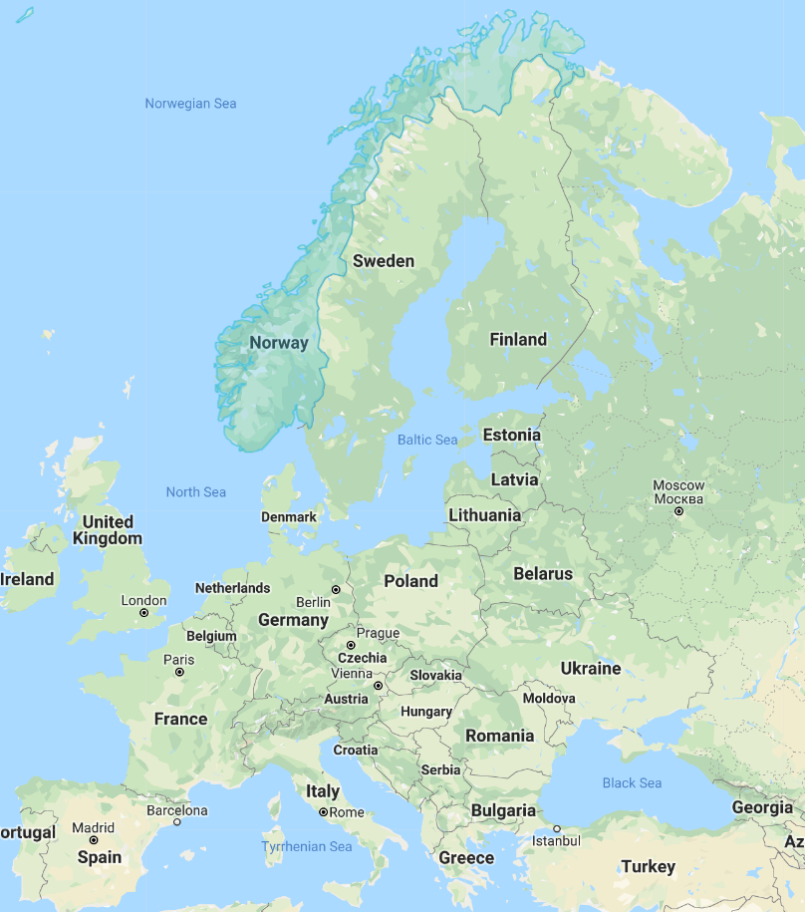
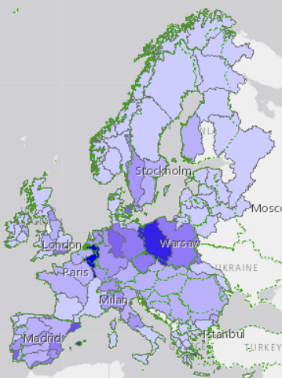
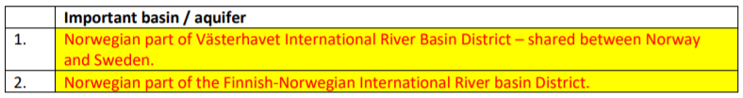
Norway – general info
Population (in '000s) 5,136
Surface area (sq. km) 385,178
Average precipitation in depth (mm per year) 1,414
Renewable internal freshwater resources per capita (cubic meters) 75,202
WEI+

Slide 4
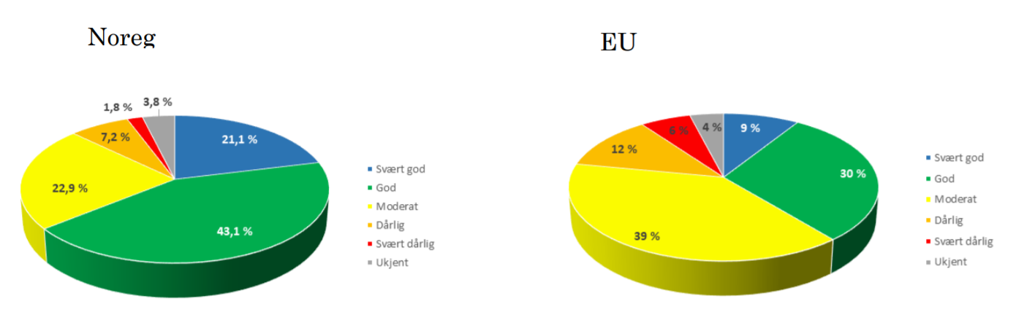
Resources overview

Slide 5
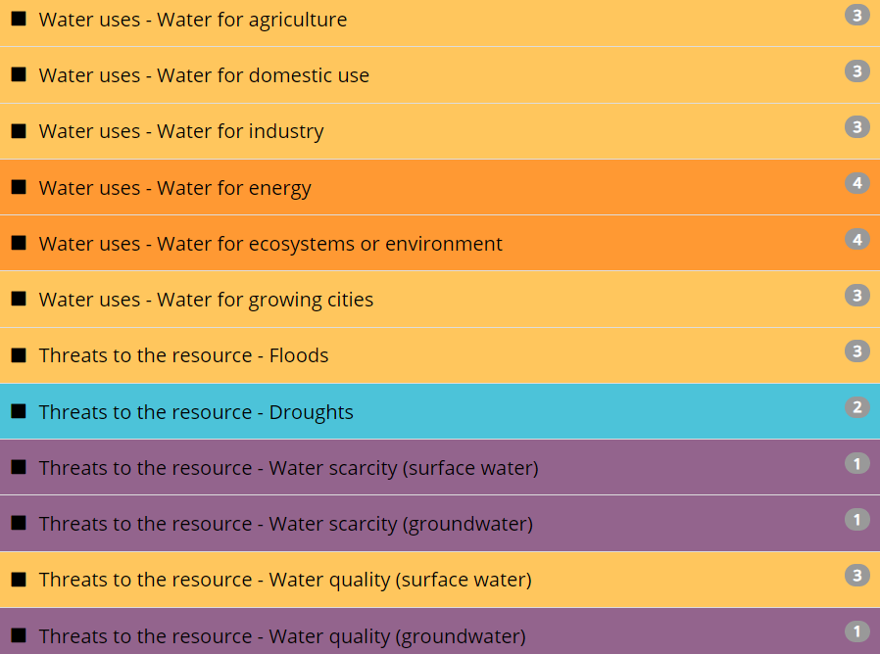
Priority water resources challenge areas

Slide 6
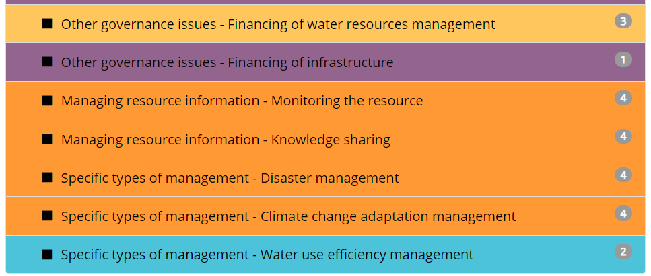
Priority water management challenge areas

Slide 7
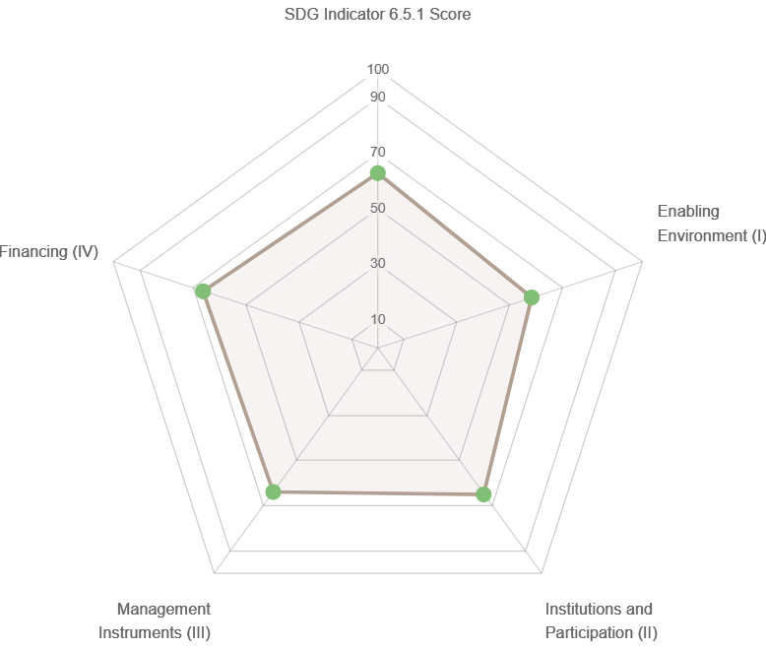
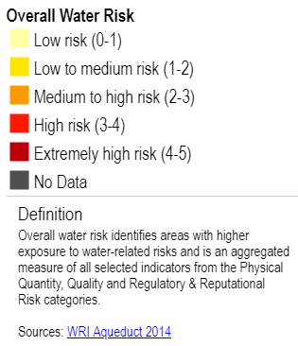
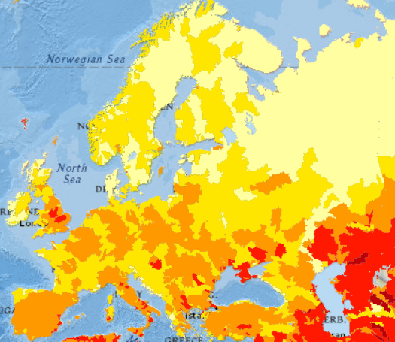
SDG 6.5.1 baseline year 2017

Slide 8
Legislation background as part of EEA agreement
IWRM has been established in Norway mainly through implementation of the EU Water Framework Directive (WFD)
2016: Governmental approval of the WFD River Basin Management Plans (RBMPs) for 2016-2021
The necessary acts are in place:
  1981: The Pollution Control Act
  2000: The Water Resources Act
  2007: The Water Regulation, transposing the EU Water Framework Directive into national legislation
  2008: The Planning and Building Act
  2009: The Natural Diversity Act. Tools for complete enforcement of the Natural Diversity Act are still under development
Arrangements for coordinated water management with neighbouring countries Sweden and Finland are in place

Slide 9
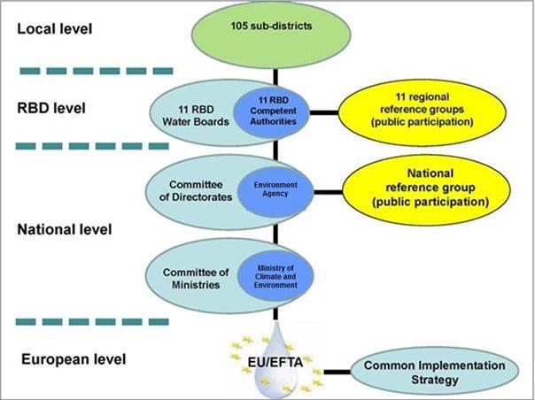
WFD implementation in Norway
Implementation of the EU Water Framework Directive (WFD) has led to a more formalised public participation in water management in Norway:
Participation of public (NGOs) and business
Stakeholders have many opportunities to take part in management processes and consultations, but are not part of formal government decision making
Developing capacity
Agency Group guidance and training courses
Master study programs – see the report
Short technical gatherings and seminars by the Norwegian Water Association – see the report

Slide 10
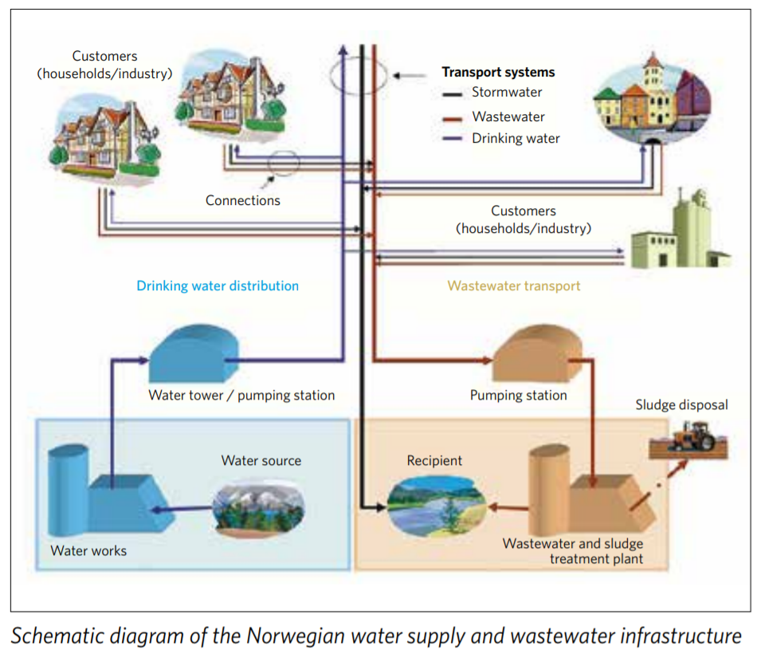
11 Water Regions

Slide 11
Ownership
The municipalities own the majority of the water and wastewater infrastructure in Norway
Some municipalities have organised the service in inter-municipal companies.
E.g. Lillestrøm plants are owned by 5-6 municipalities
In 2012, the Norwegian parliament approved a law on municipal water and wastewater infrastructure, stating that the infrastructure has to be owned by the municipalities and cannot be privatised.
The concept today is to keep in public ownership, but run as private companies.
A single Norwegian household pays on average 7000 NOK (850 EUR) in total fees for water and wastewater services

Slide 12
Transboundary water management
harmonize knowledge, data and assessments
coordinate monitoring, objectives and measures
coordinate consultations
share experiences
produce coordinated management plans or joint roof reports
establish and execute joint research and development activities

Slide 13
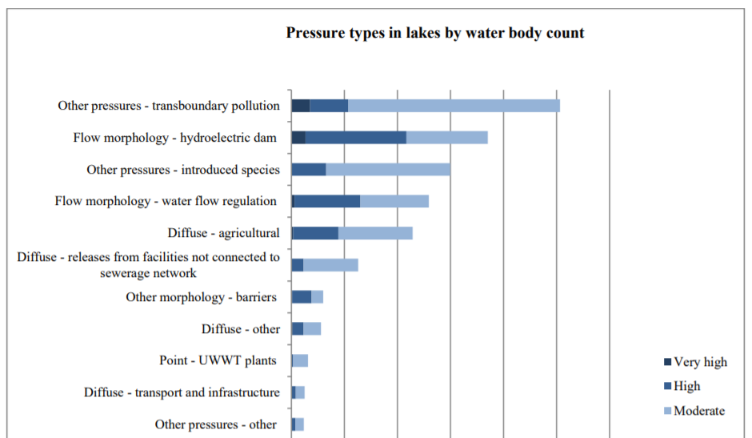
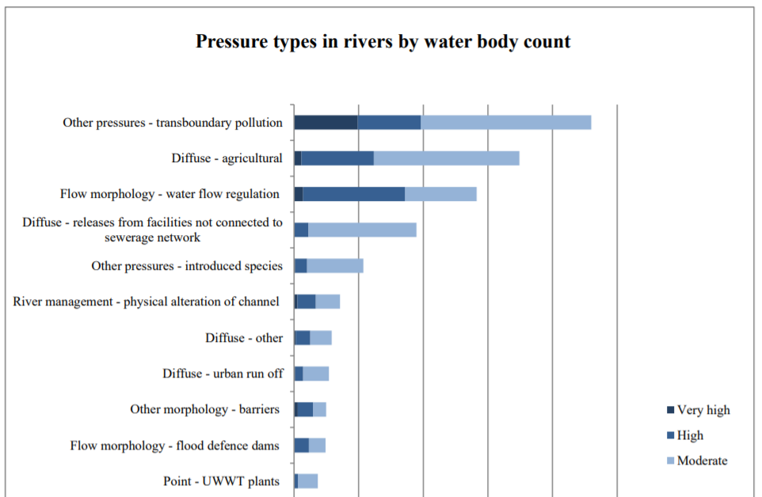

Slide 14
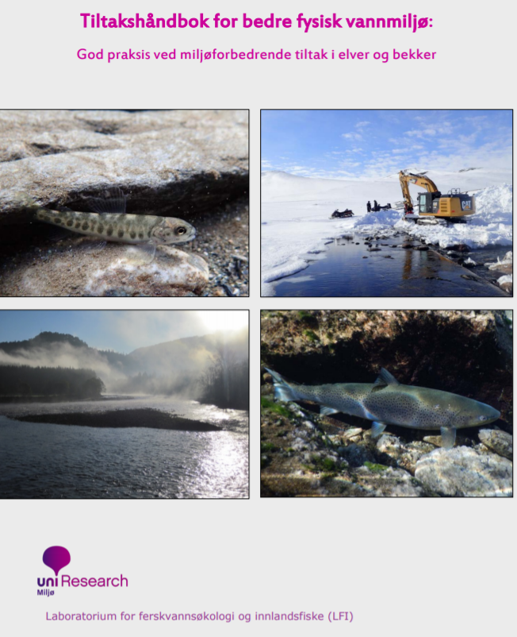
Management of water-related ecosystems
Salmonid and inland freshwater species are additionally managed according to a specific law on fish stock management
A national action plan for natural diversity was approved by the parliament recently

Slide 15
Management of water-related ecosystems
Flood management system
The Norwegian Water Resources and Energy Directorate administers a comprehensive flood management system that includes guidelines and expert guidance in mapping programs for flood inundation and quick clay slides, several guidelines for land use planning, planning and financial and practical assistance for building physical flood protection works such as levees and embankments, a flood warning system, and an emergency preparedness system. For more information see https://www.nve.no/flaum-og-skred/ and www.varsom.no

Slide 16
Management of water-related ecosystems
Climate Change adaptation
The Norwegian Environment Agency assists the Ministry of Climate and Environment on Climate Change Adaptation (CCA) matters, and is responsible for maintaining and developing the Norwegian portal for climate change adaptation intended to support the society in Norway in preparing for the consequences of climate change. The portal offers comprehensive information about ongoing work on climate change adaptation in Norway, lessons learned and relevant research, developments and publications: http://www.klimatilpasning.no/infosider/english/

Slide 17
Management of water-related ecosystems
Preparedness
"Crisis-information" http://www.kriseinfo.no/en/ is the official Norwegian website providing valid and secure information to the general public before, during and after a crisis. The website presents updated and coordinated information from relevant Norwegian authorities and emergency actors. Extreme weather and floods are among the possible crisis covered.

Slide 18
Data and information sharing within countries
The Norwegian Water Information System "Vann-Nett" was developed as a management and information tool to facilitate the implementation of the EU Water Framework Directive: http://www.vannportalen.no/verktoy-og-kart1/vann-nett/
Water managers in relevant authorities at all levels may use it as a management tool, and stakeholders as well as the public can use it to access information

Slide 19

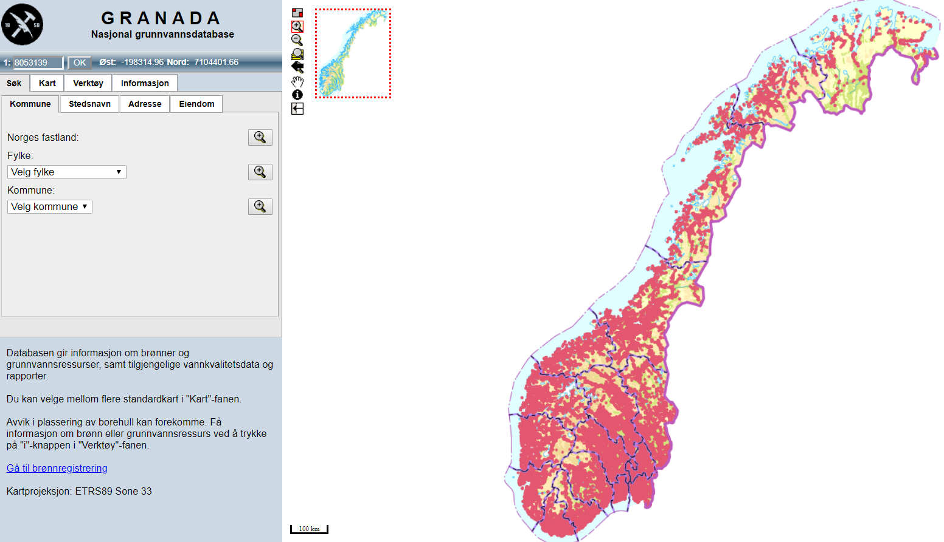

National groundwater system database

Slide 20
Innovations

Slide 21
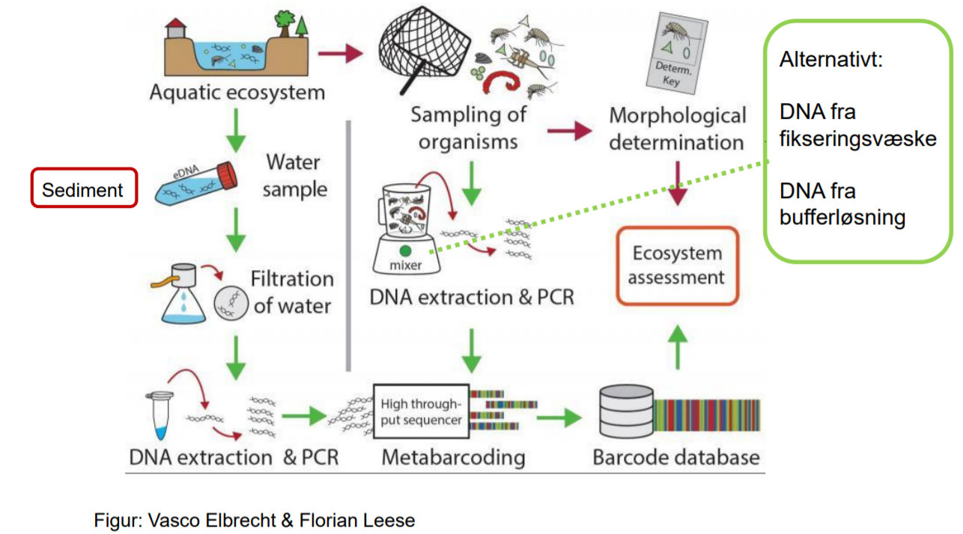
DNA for biomonitoring of water quality

Slide 22
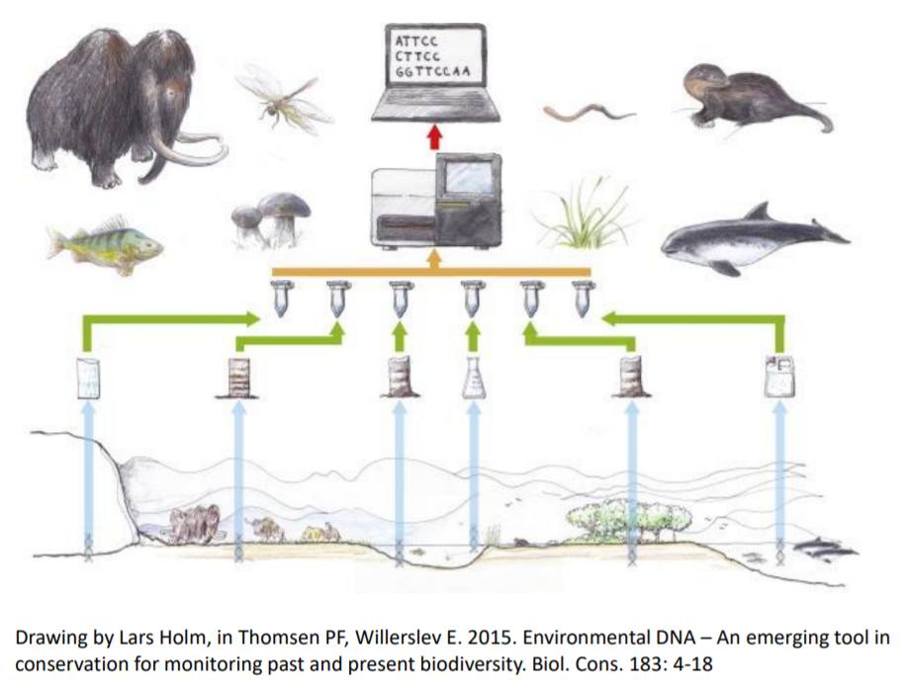
DNA for biomonitoring of water quality

Slide 23
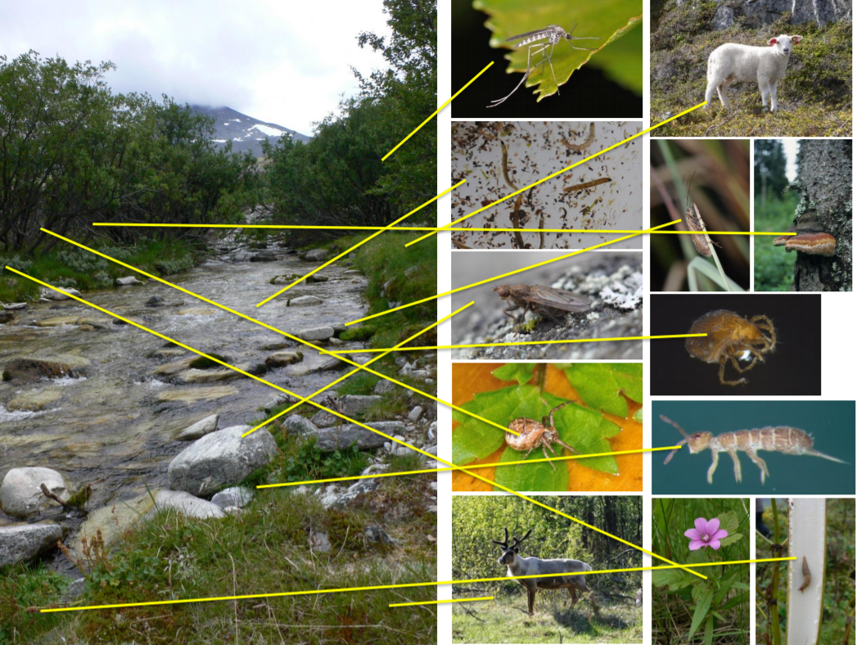
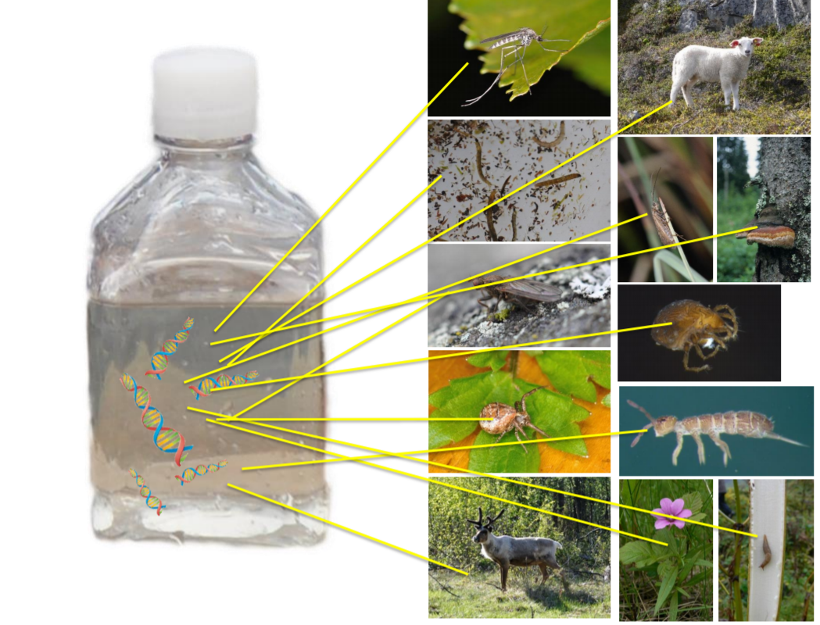
DNA for biomonitoring of water quality

Slide 24
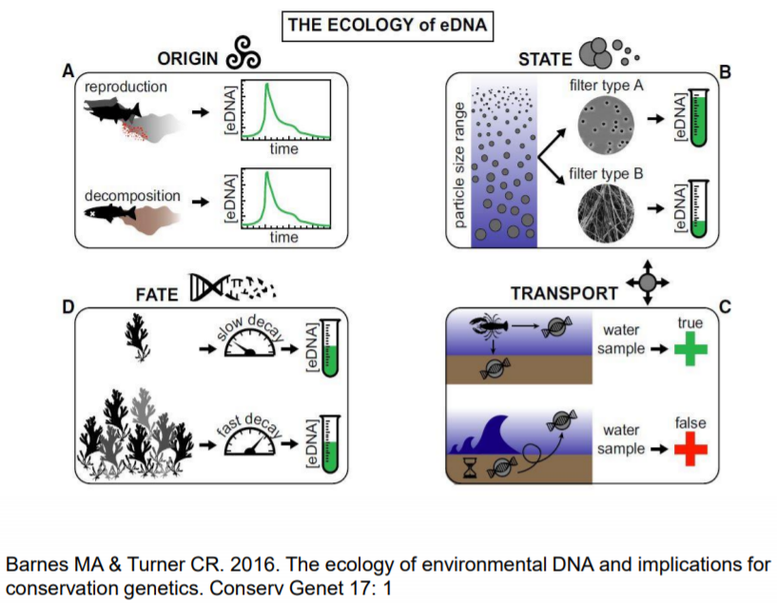
DNA for biomonitoring of water quality

Slide 25
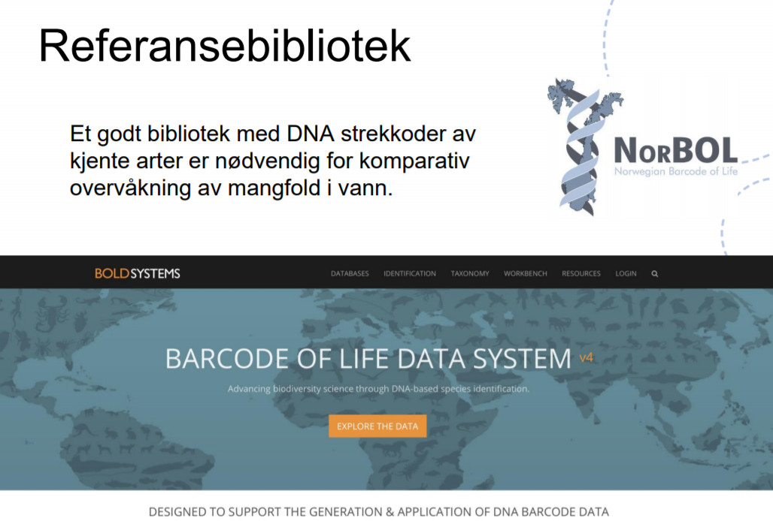
DNA for biomonitoring of water quality

Slide 26
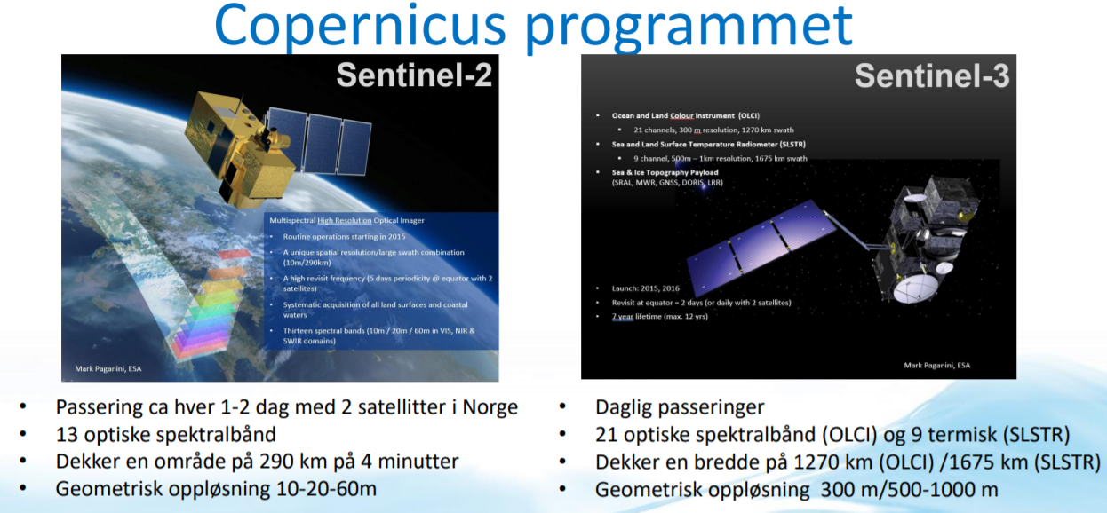
Satellite data for monitoring of coastal waters and lakes

Slide 27
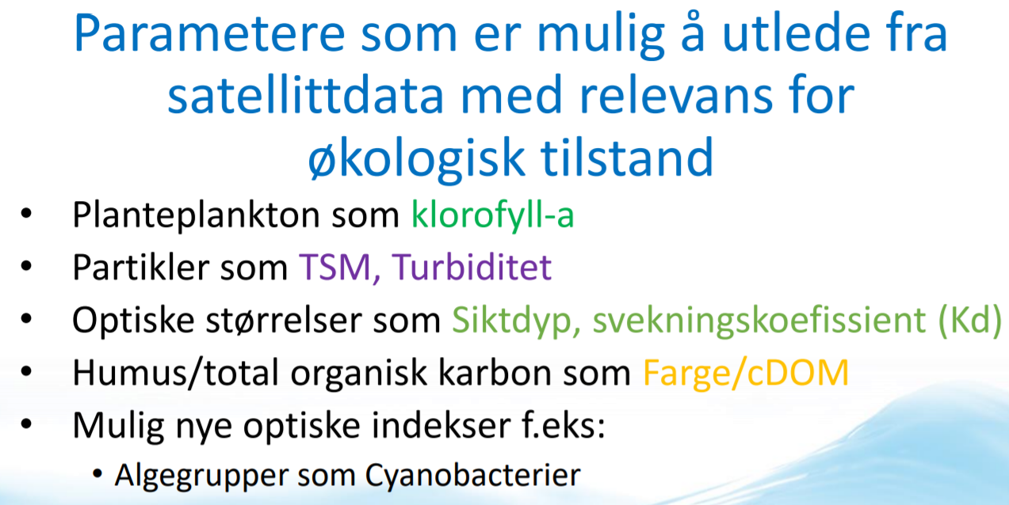
Satellite data for monitoring of coastal waters and lakes

Slide 28
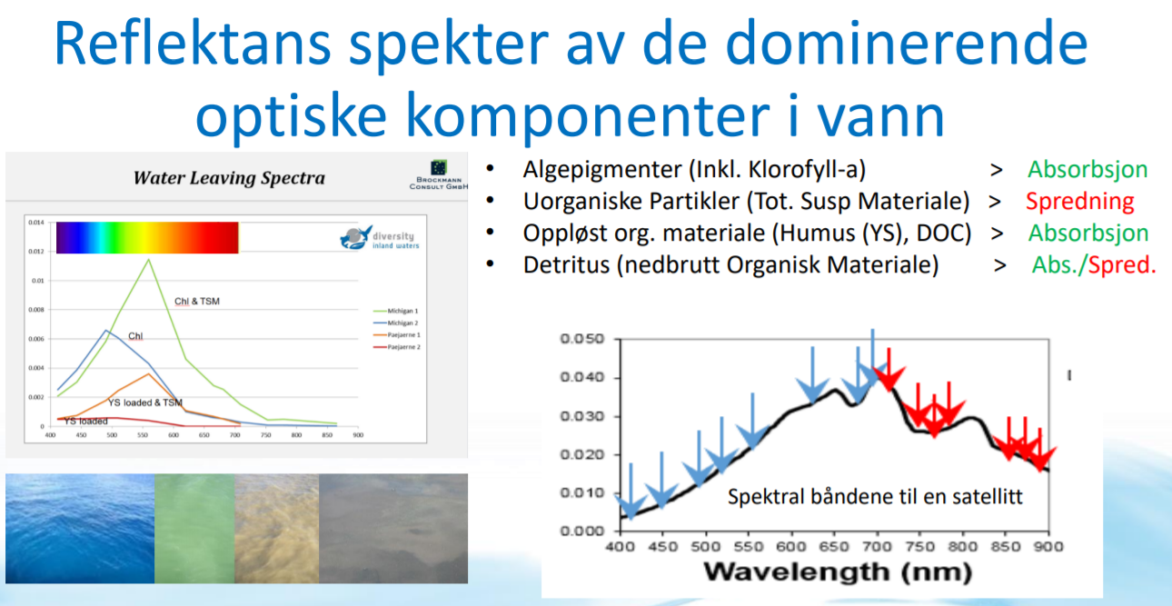
Satellite data for monitoring of coastal waters and lakes

Slide 29
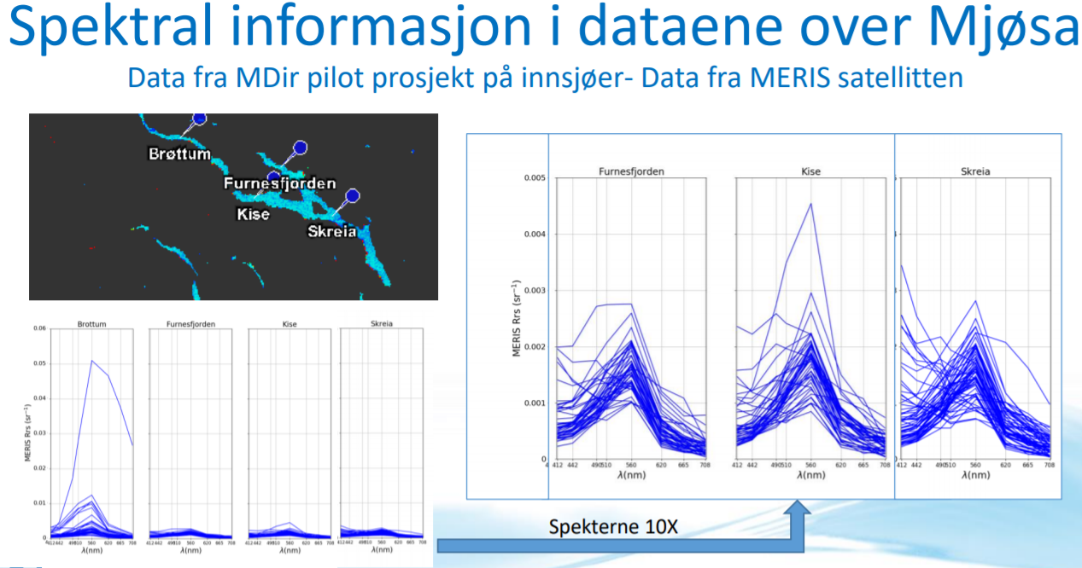
Satellite data for monitoring of coastal waters and lakes

Slide 30
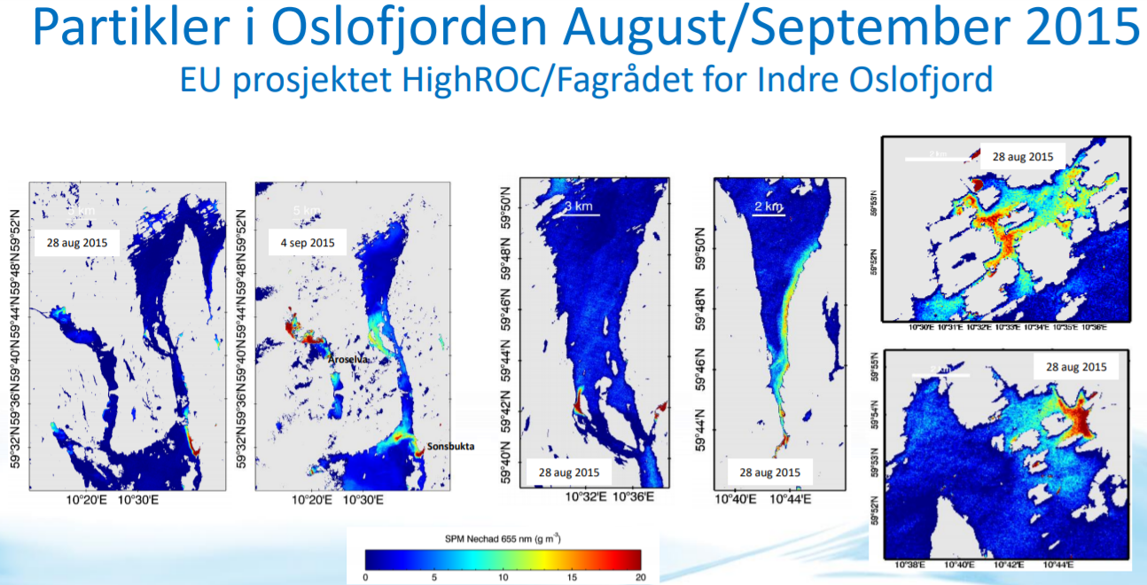
Satellite data for monitoring of coastal waters and lakes

Slide 31
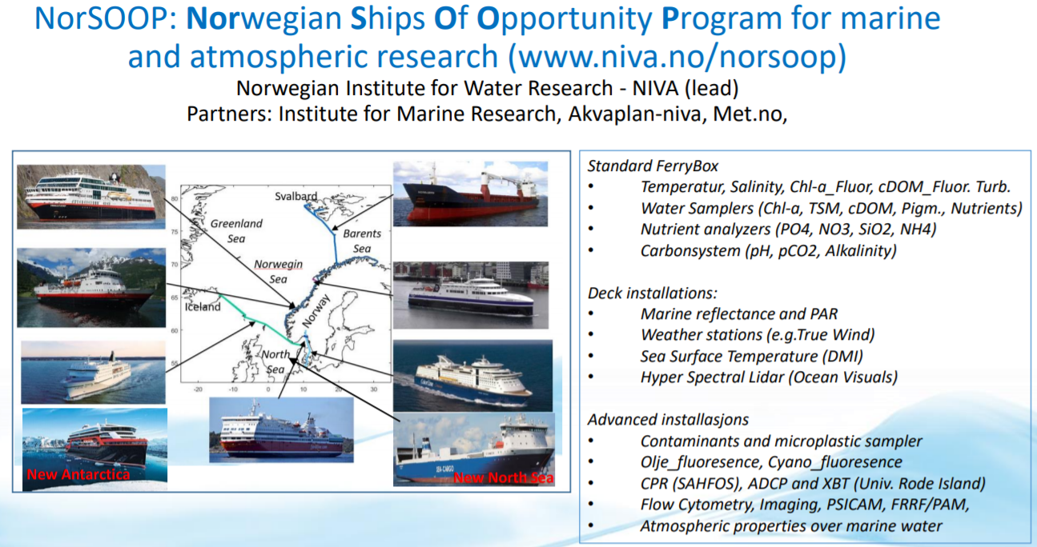
Satellite data for monitoring of coastal waters and lakes

Slide 32
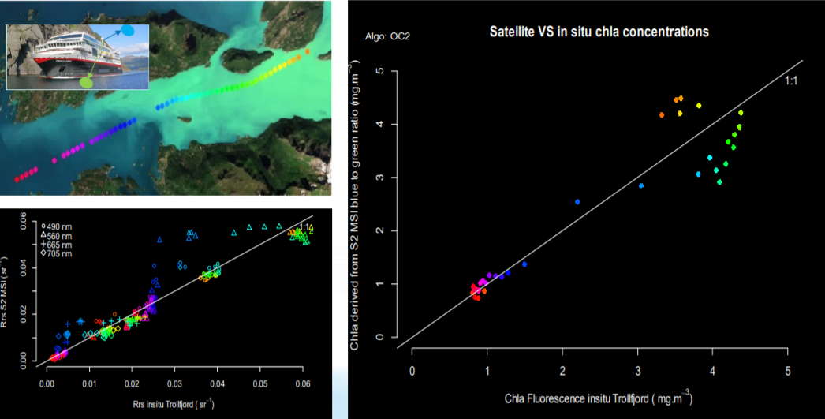
Satellite data for monitoring of coastal waters and lakes

Slide 33
Non-target screening
Effect-based

Slide 34
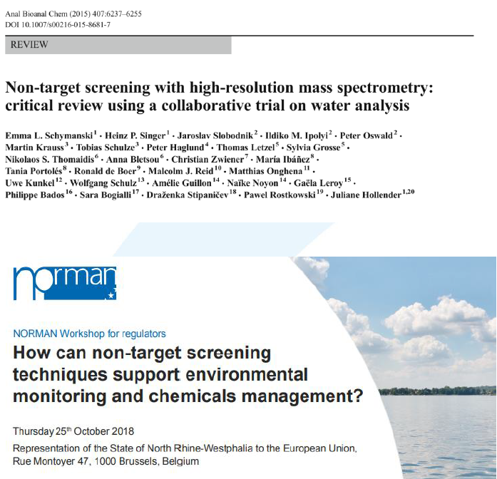
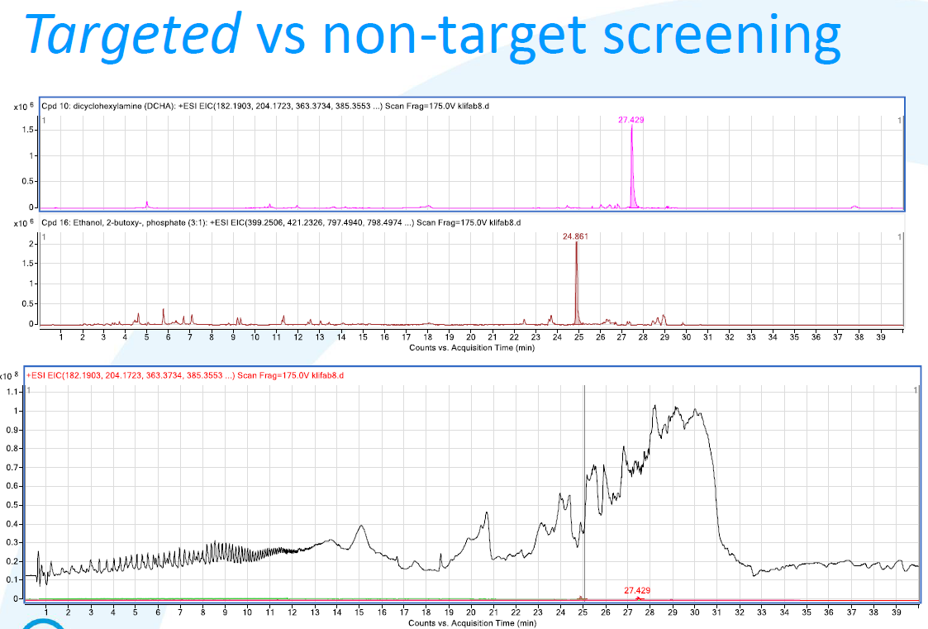
Non-target screening
Not specific screening
Based on new type of mass-spectrometry
1000 parameters at a time

Slide 35
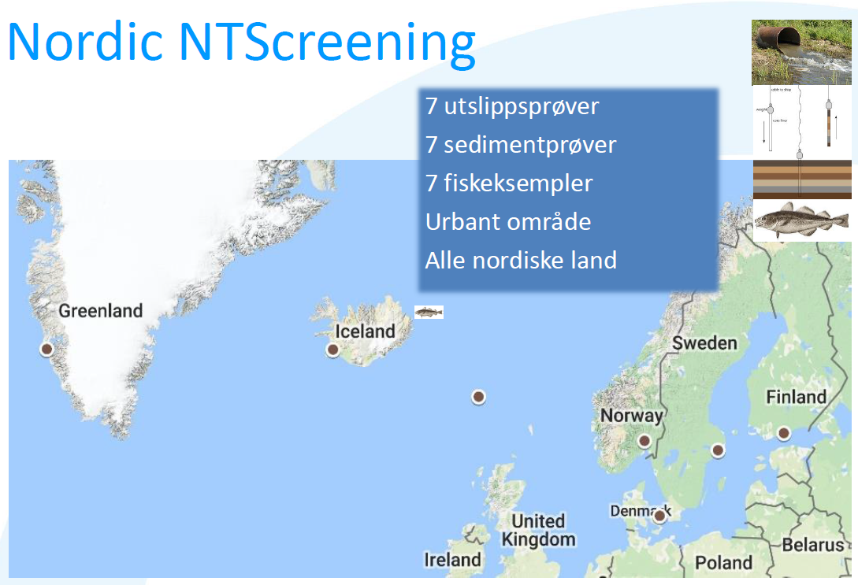
Non-target screening

Slide 36
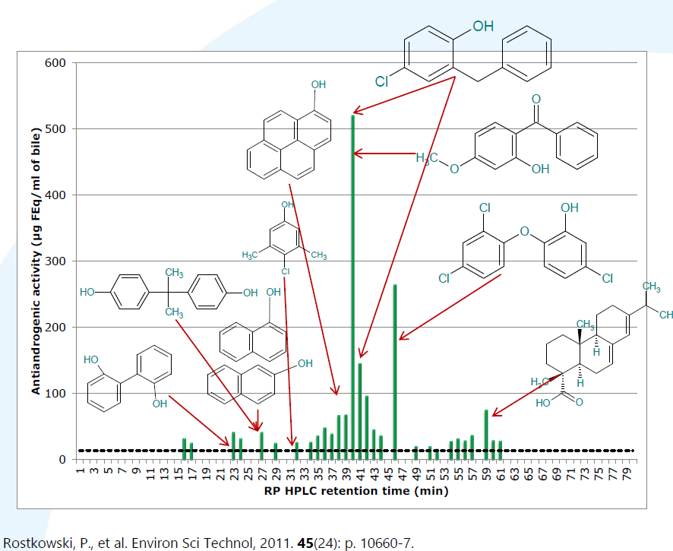
Non-target screening

Slide 37
Hydromorphological classification system
Evaluation of management tools for improved characterization of water bodies and hydromorphological classification of conditions
With main focus on rivers according to EU WFD
Connection with data on ecological status

Slide 38
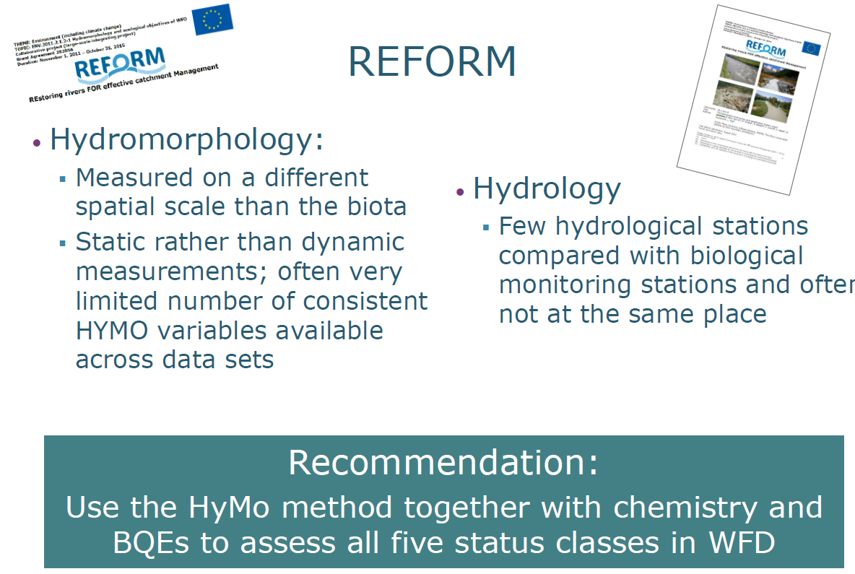
Hydromorphological classification system

Slide 39
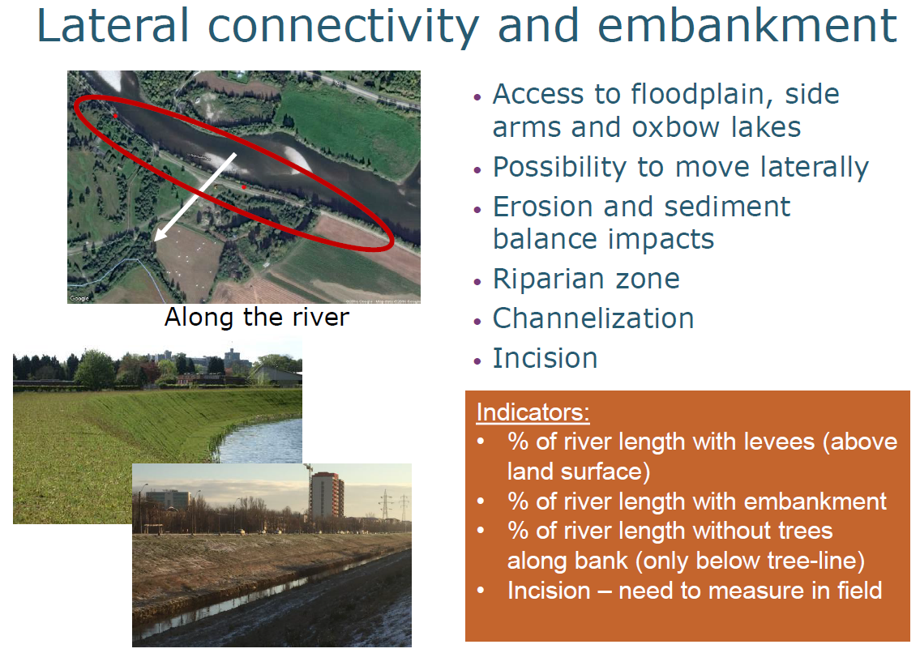
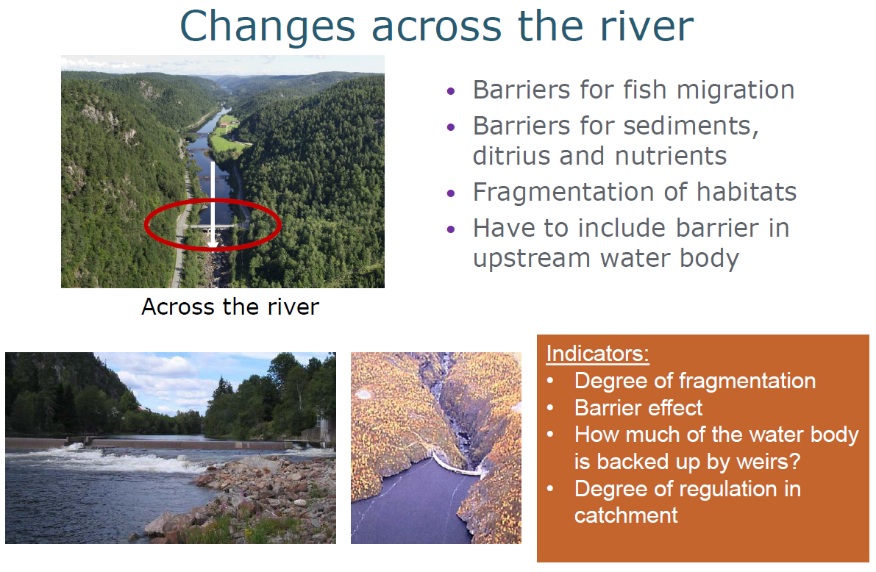
Hydromorphological classification system

Slide 40
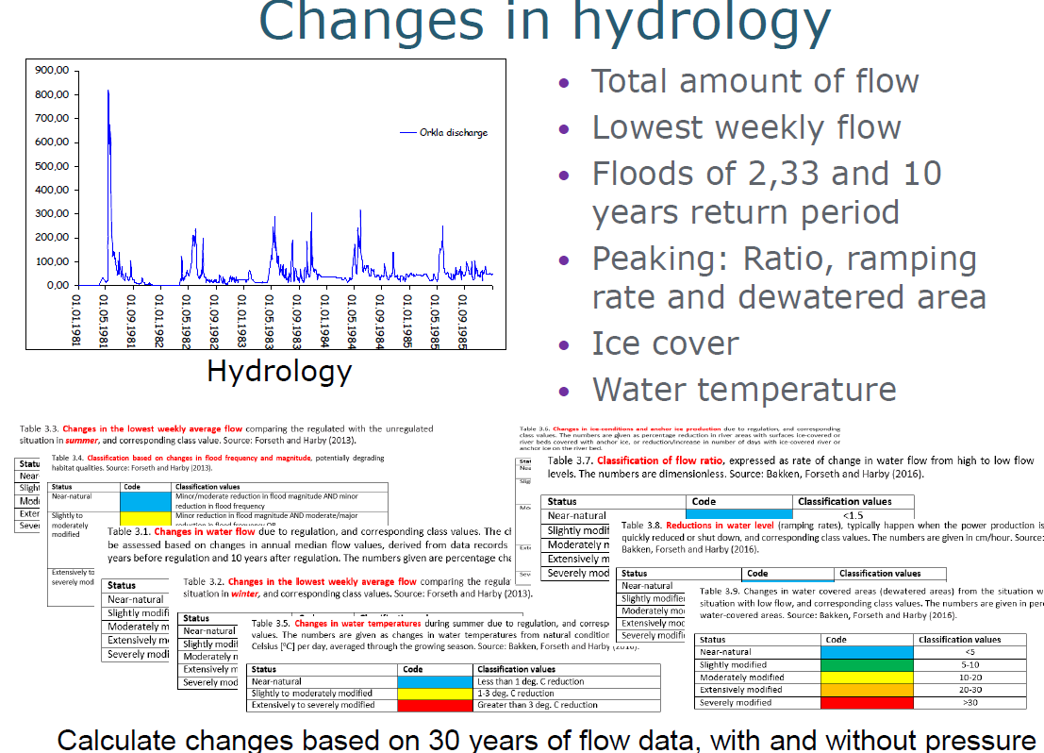
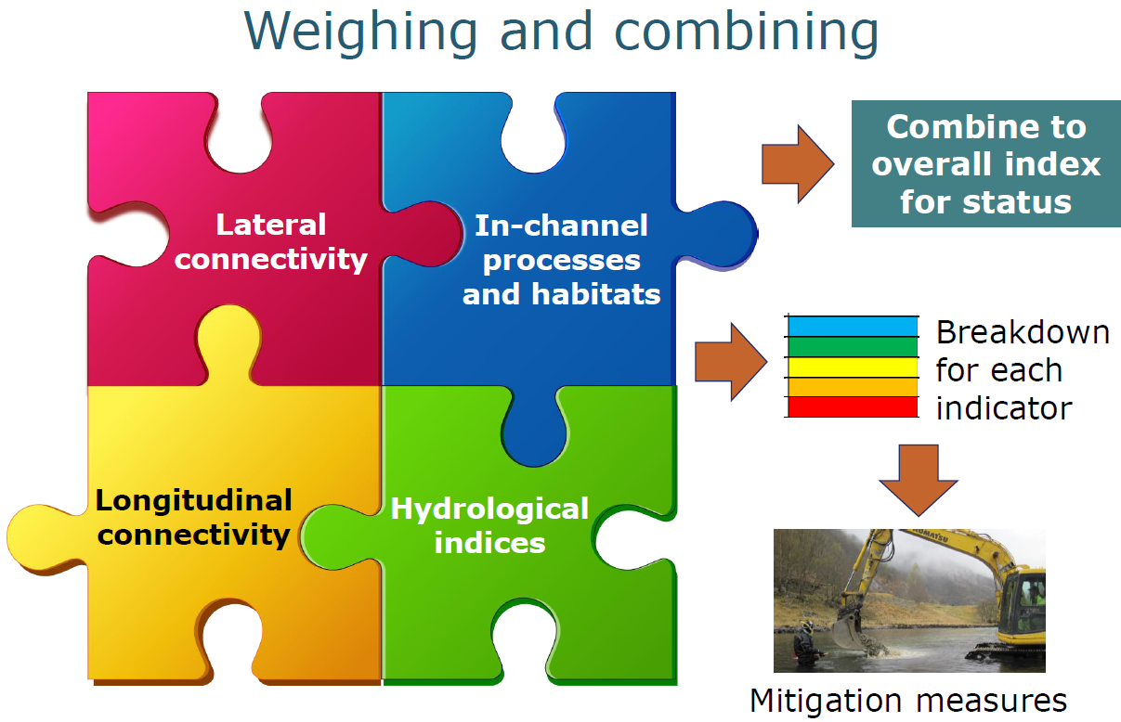
Hydromorphological classification system

Slide 41
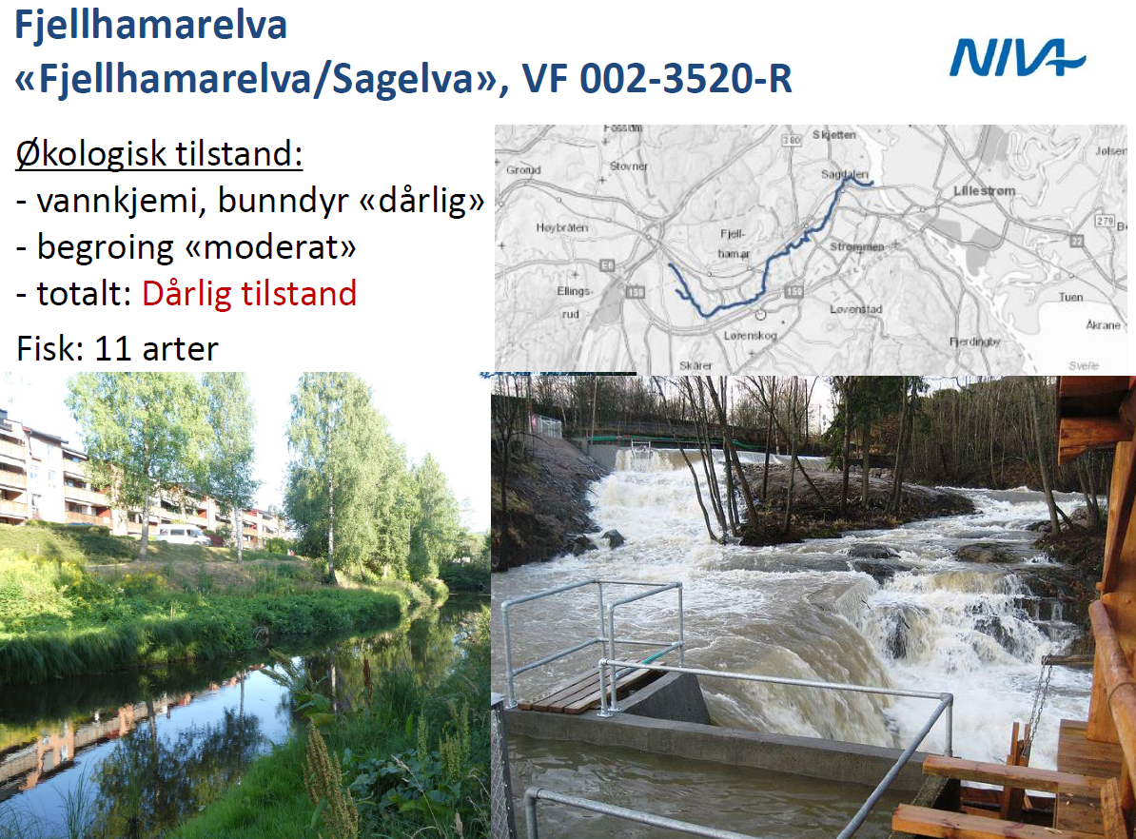
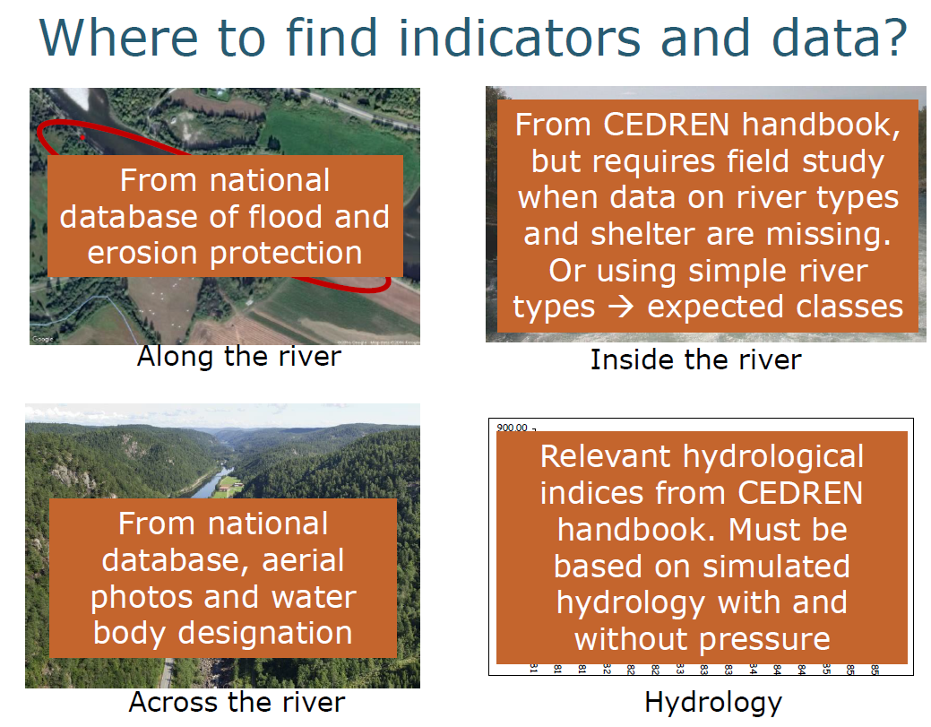
Hydromorphological classification system

Slide 42
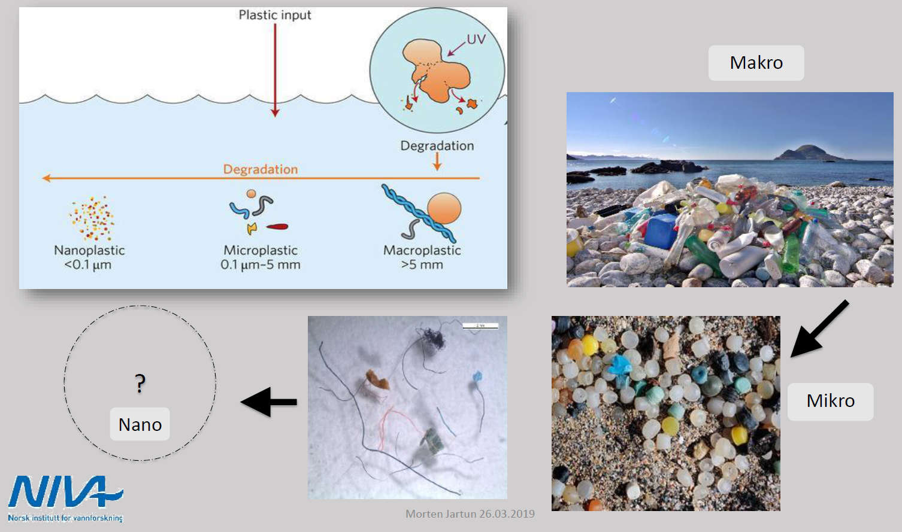
Microplastics contamination

Slide 43
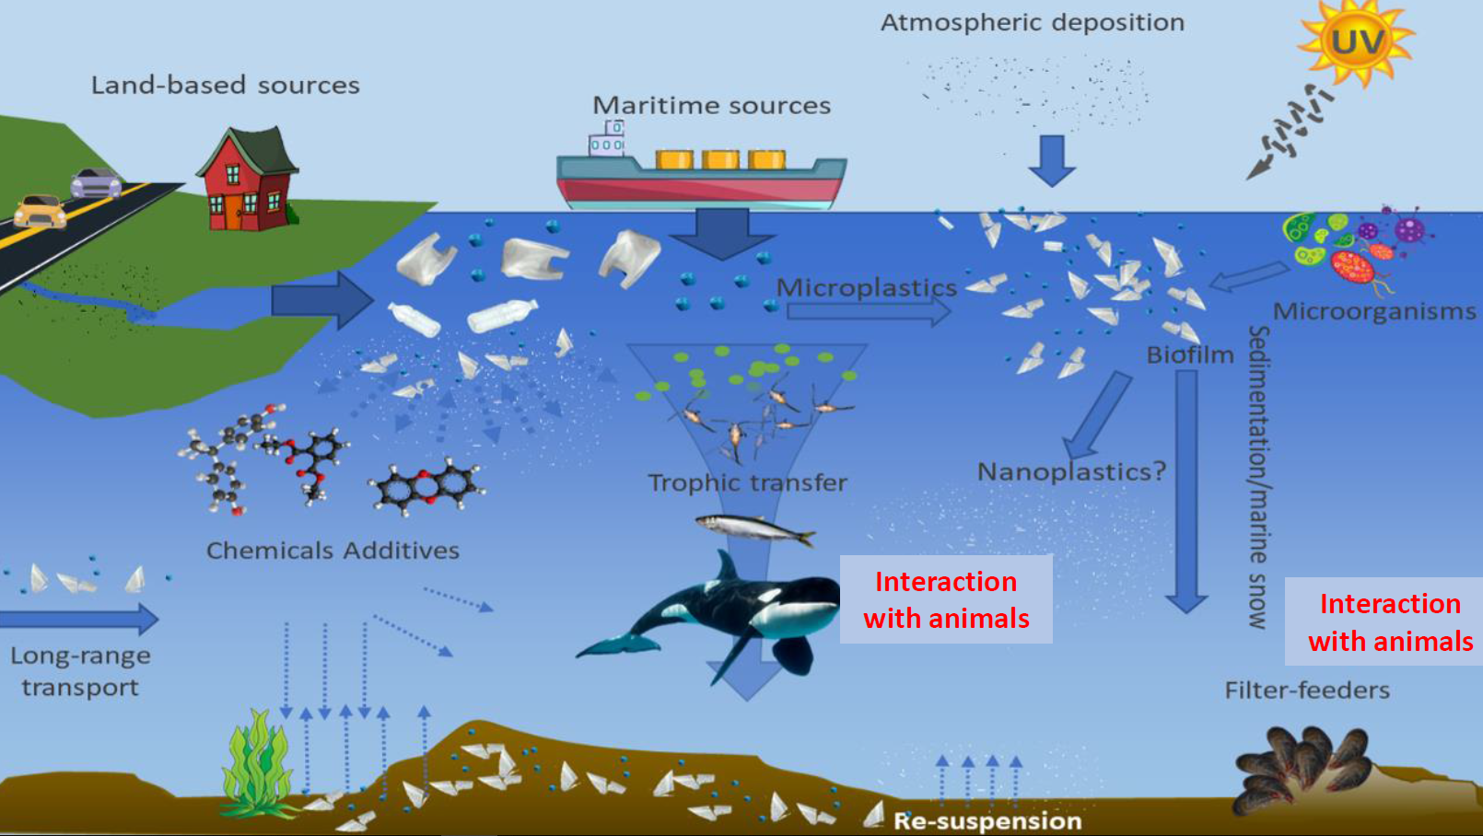
Microplastics contamination

Slide 44
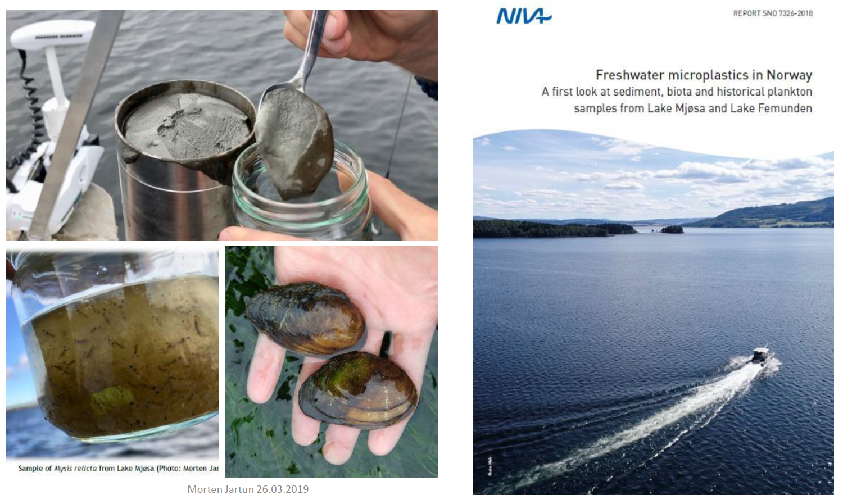
Microplastics contamination

Slide 45
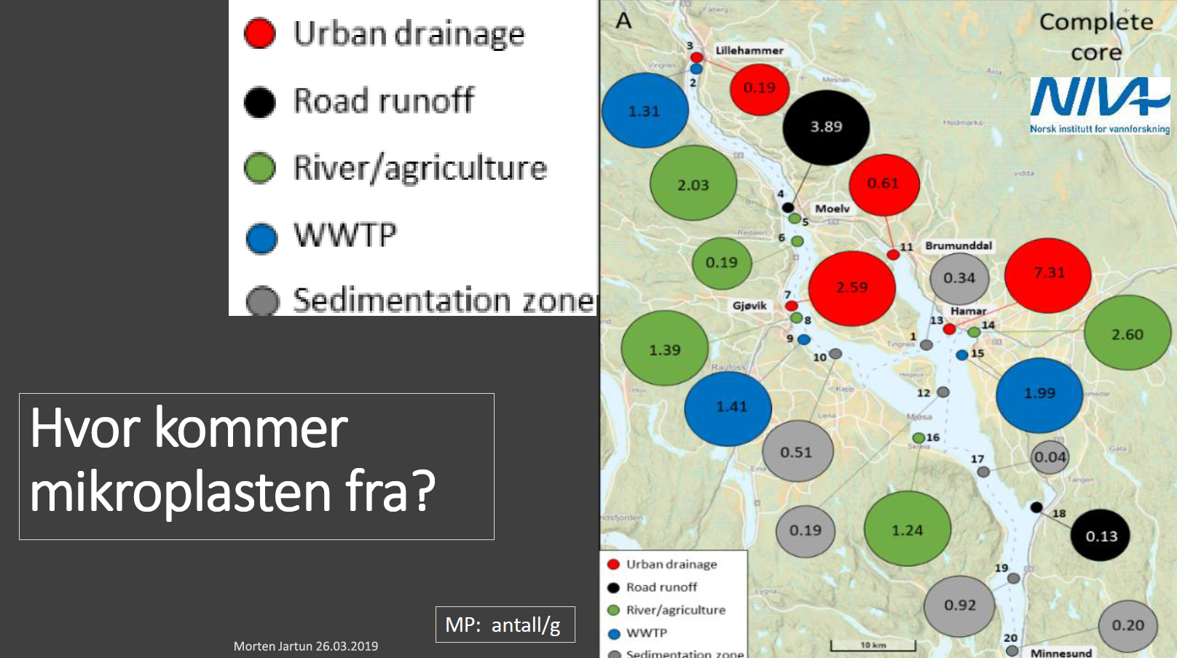
Microplastics contamination

Slide 46
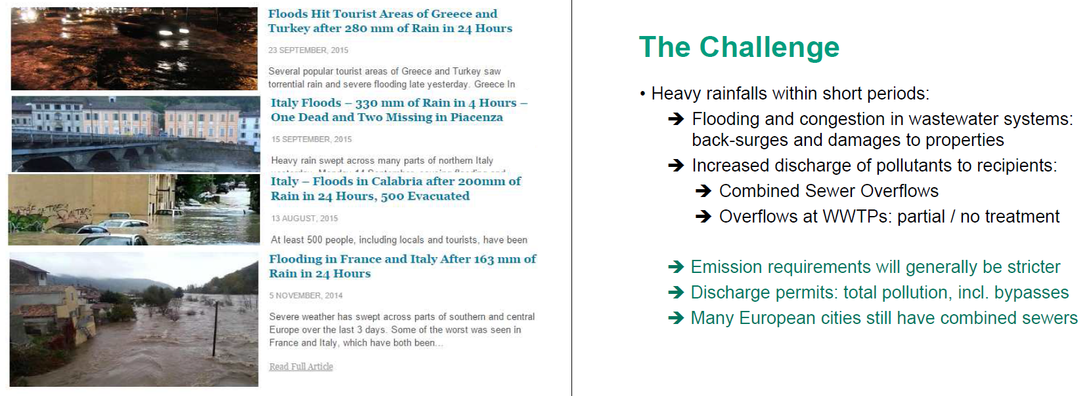
Holistic optimization of sewers and treatment plants using real-time control

Slide 47
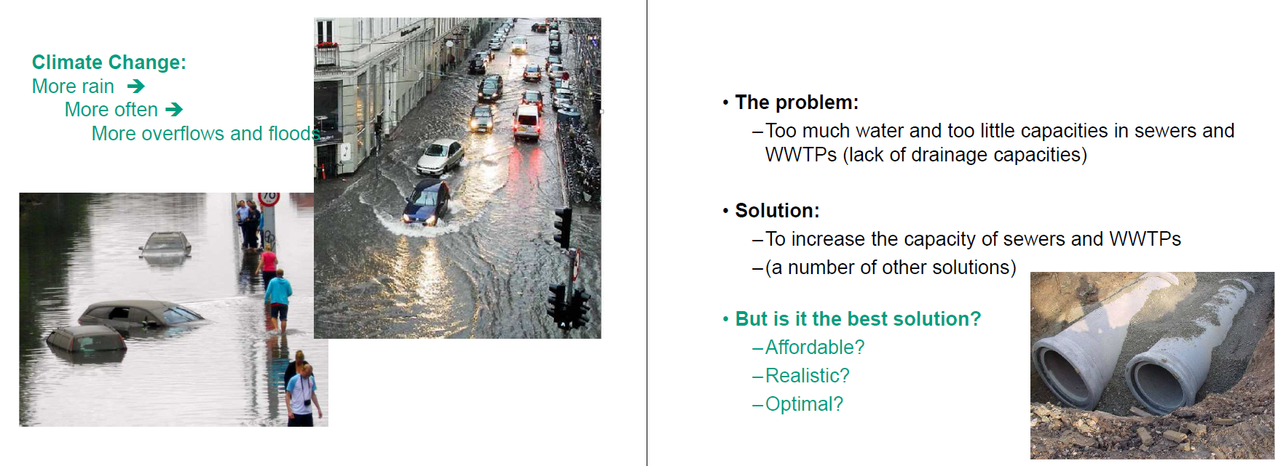
Holistic optimization of sewers and treatment plants using real-time control

Slide 48
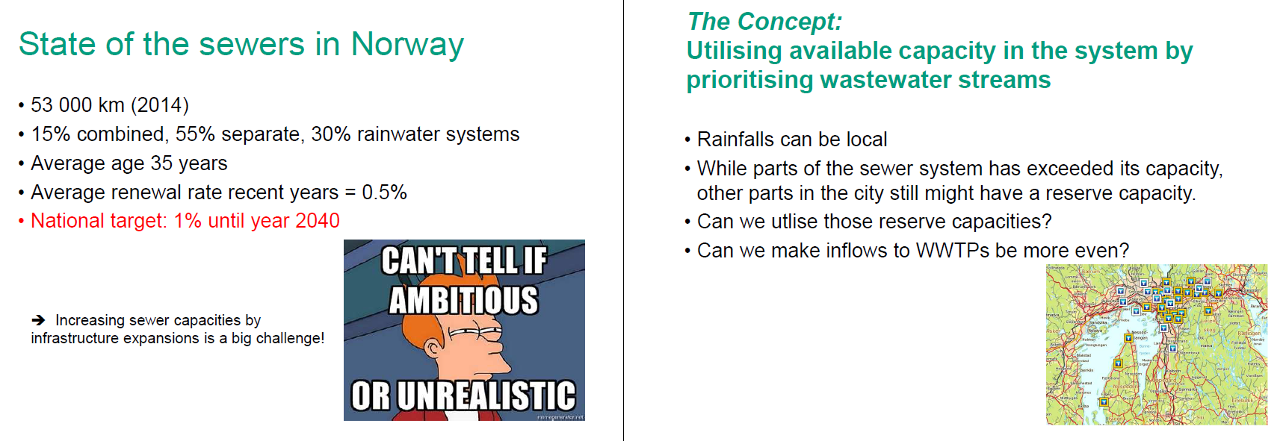
Holistic optimization of sewers and treatment plants using real-time control

Slide 49
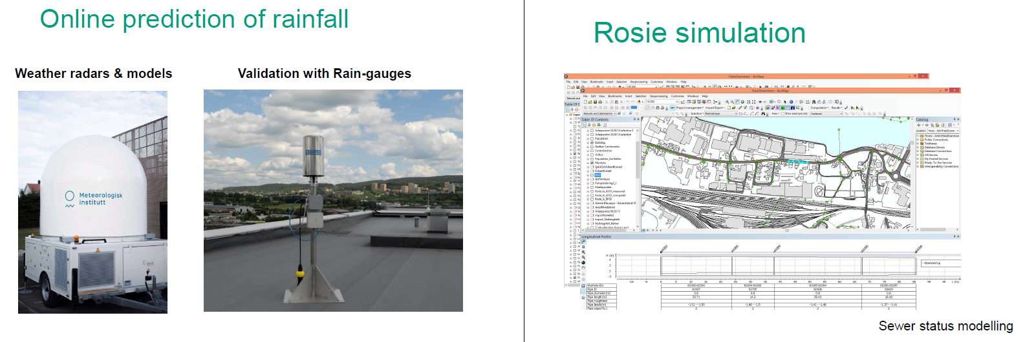
Holistic optimization of sewers and treatment plants using real-time control

Slide 50
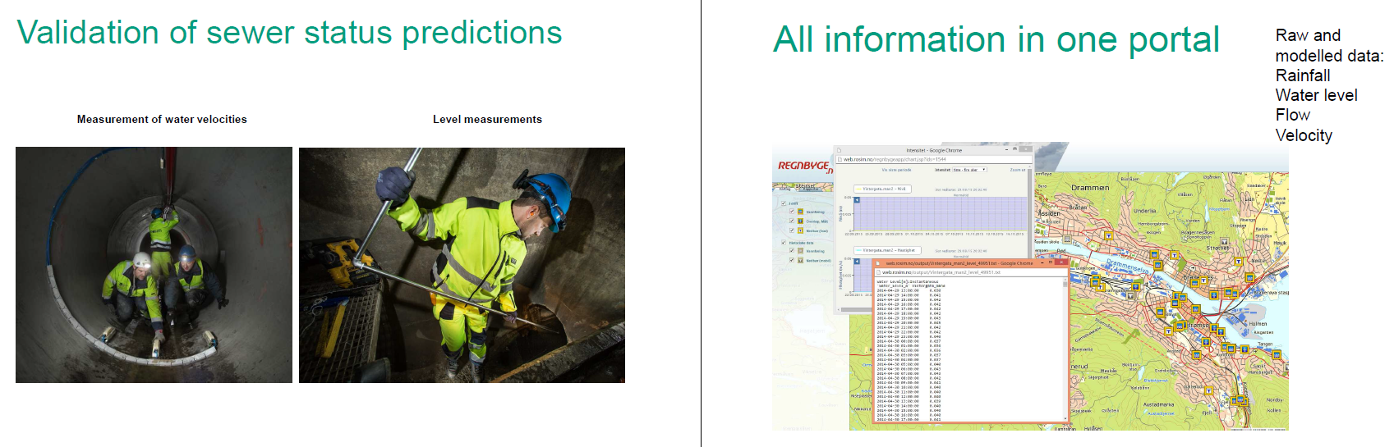
Holistic optimization of sewers and treatment plants using real-time control

Slide 51
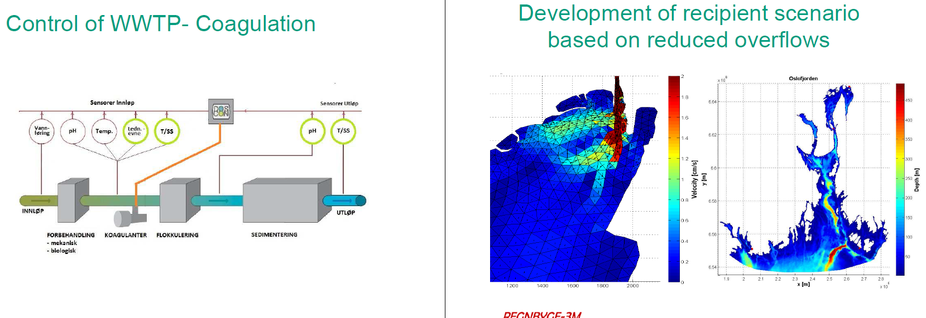
Holistic optimization of sewers and treatment plants using real-time control

Slide 52
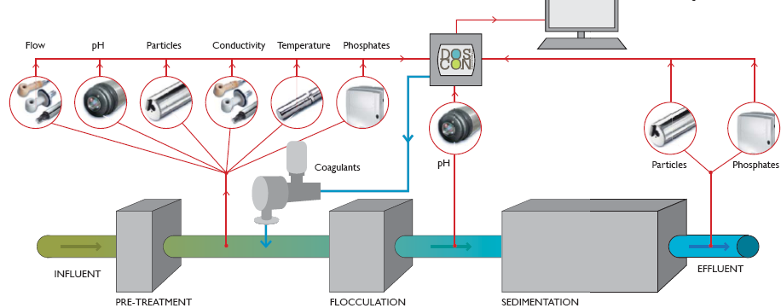
DOSCON estimates the optimal dosing based on real-time measurement of several parameters
D=f(Q, pH, P, SS, temp, Cond, etc)

Slide 53
Optimal dosages and images of flocs
Floc features detection limit
GLCM

Slide 54



Slide 55



Slide 56


Slide 57
Trends

Slide 58



GDP World = 80.7 trillion USD
(2017)
90% of world’s GDP
is dependent on water
589 billion USD = Water and wastewater treatment and distribution market
(4% annual growth)
a market value of all final goods and services from a nation in a given year

Slide 59
What it's all about
Water market
Water sources
Consumers
Manufacturers of components
Technology providers
OEMs
Consultants
…
Surface water
Groundwater
Seawater
Wastewater
Municipal
Industrial
Households
Services
Recovered
substances
Wastewater,
Residuals
Reclaimed water
Resources

Slide 60
3 Hypes of 2018
Circular Economy
Digitalization
Emerging Contaminants

Slide 61


Slide 62


Automation…
Can you imagine a water utility without any automation and/or remote surveillance?
The SCADA market for water and wastewater management is predicted to reach US$ 2.2 billion
by 2025, an increase from US$ 1.3 billion in 2015.
Transparency Market Research (TMR)

Slide 63





Explore widely available supporting tools
Special edition on Cyber water

Slide 64
Relation with Water Crisis
Emerging Contaminants – New Challenges
PPCPs, POPs etc with little known health effects anticipated in decades after
Monitoring in complex environment and transformation products (nano-micro concentrations, expensive in monitoring)
Sorption on microplastics, suspended material, bioaccumulation/biodegradation, transfer in biofilms
Removal efficiency and breakdown products in treatment processes

Slide 65


Slide 66
New regulations
Beta-estradiol
Bisphenol A
Haloacetic acids
Microcystin-LR
Nonylphenol
PFASs

Slide 67
What's next?
??
?
?

Slide 68


Slide 69





Slide 70


